Slide 1


SOFTWARE AND DESIGN ANALYSIS FINAL PROJECT’24
Food Ninja

Slide 2
INTRODUCTION
Provide users with a convenient and efficient way to order food from local restaurants.
Browse menus and place orders
Rate meals and delivery experiences
Avoid long waiting lines at restaurant.
Featuring restaurants with discounts for cheaper meals.
It targets users in metropolitan areas with active restaurant and food delivery services

Slide 3
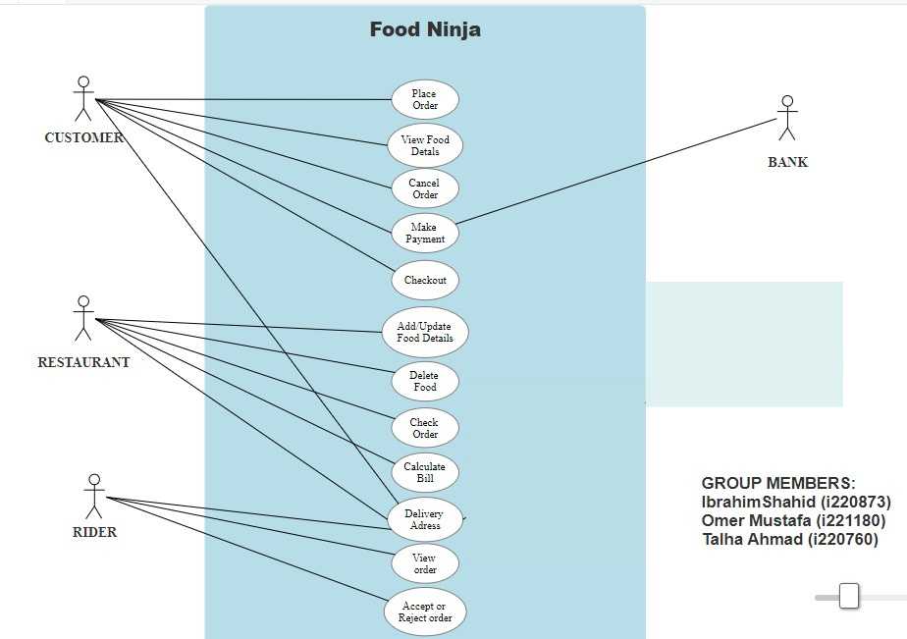

USE CASE DIAGRAM

Slide 4
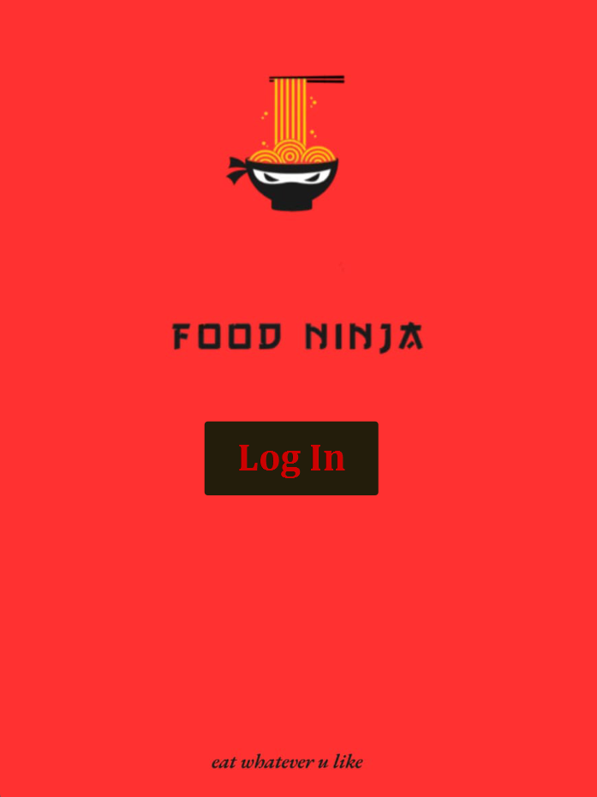
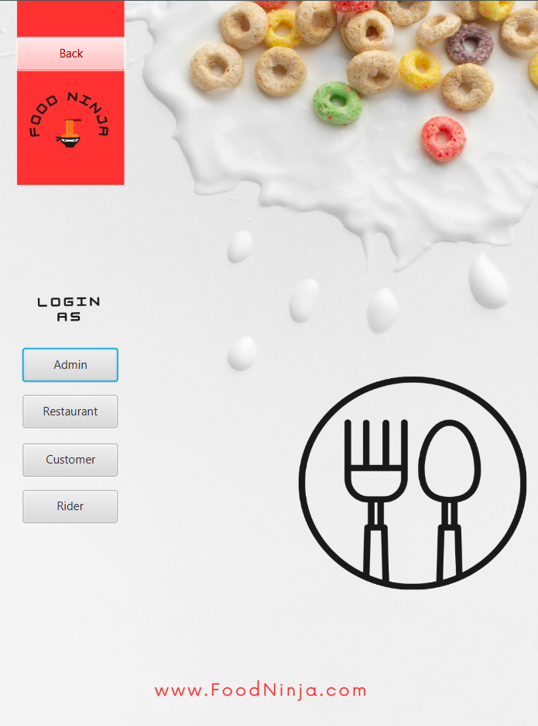
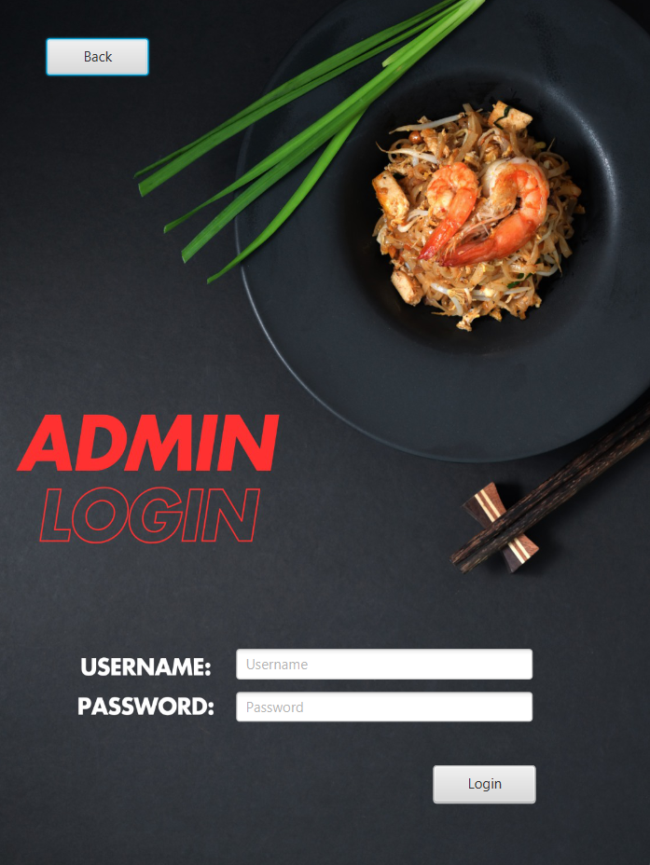
USER INTERFACES - DEMO

Slide 5
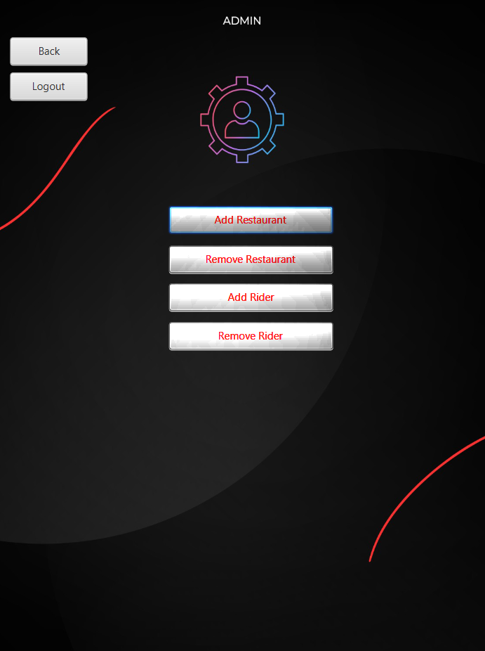
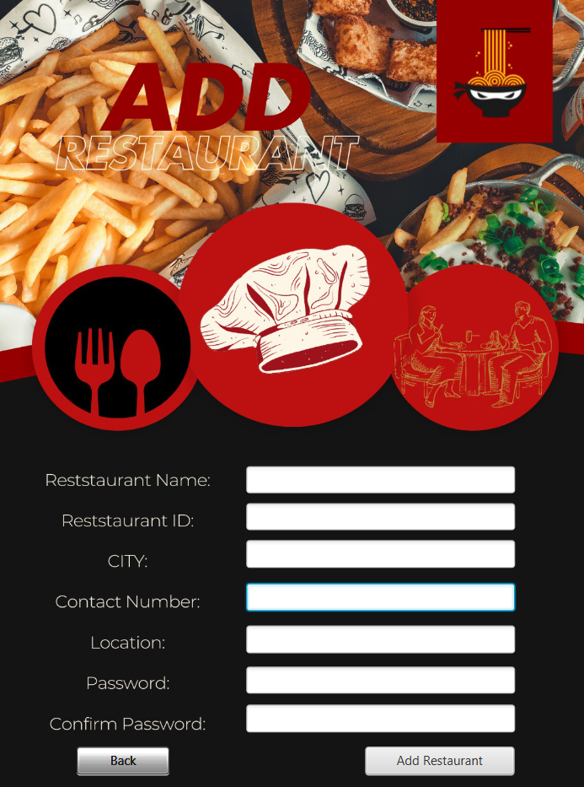
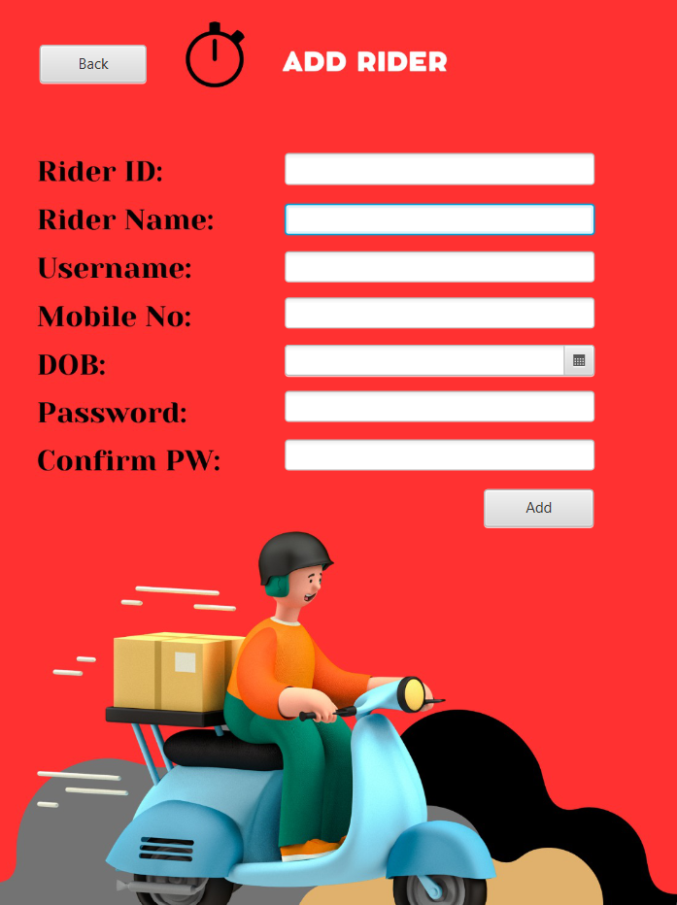
USER INTERFACES - DEMO

Slide 6
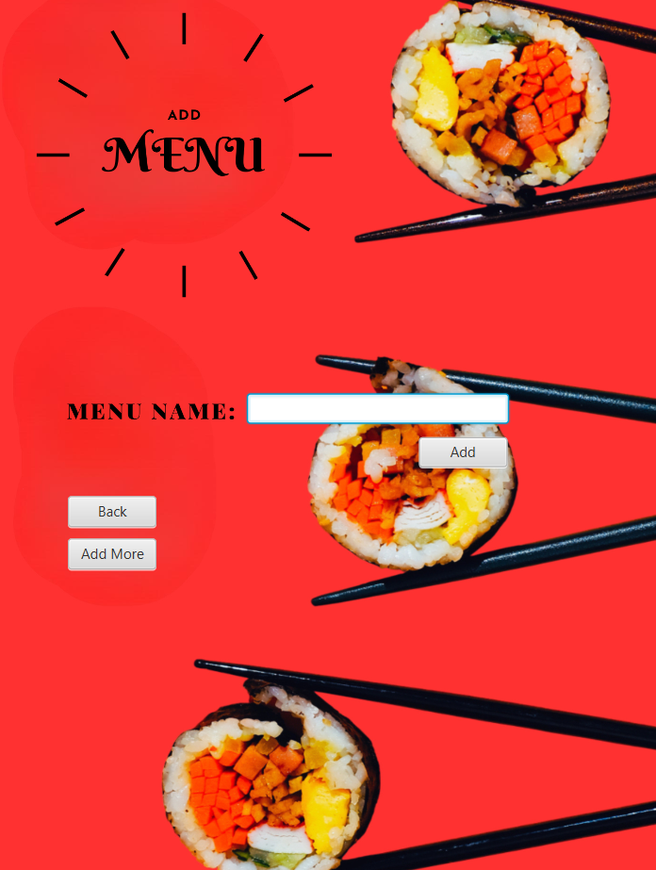
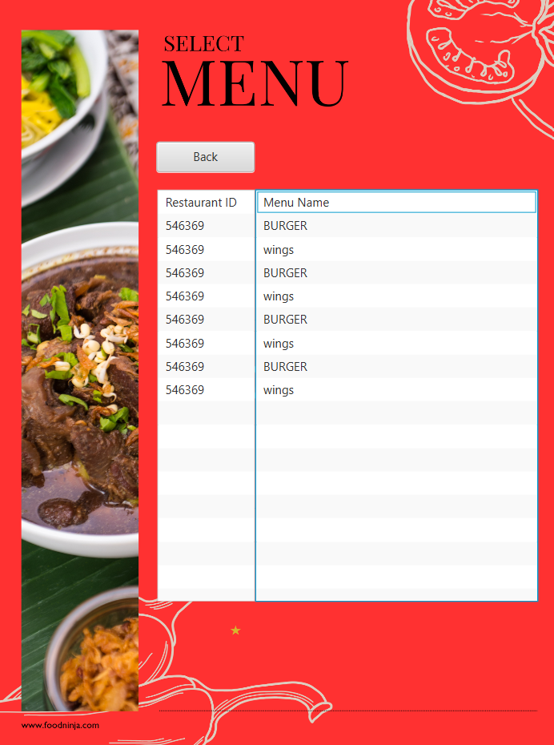
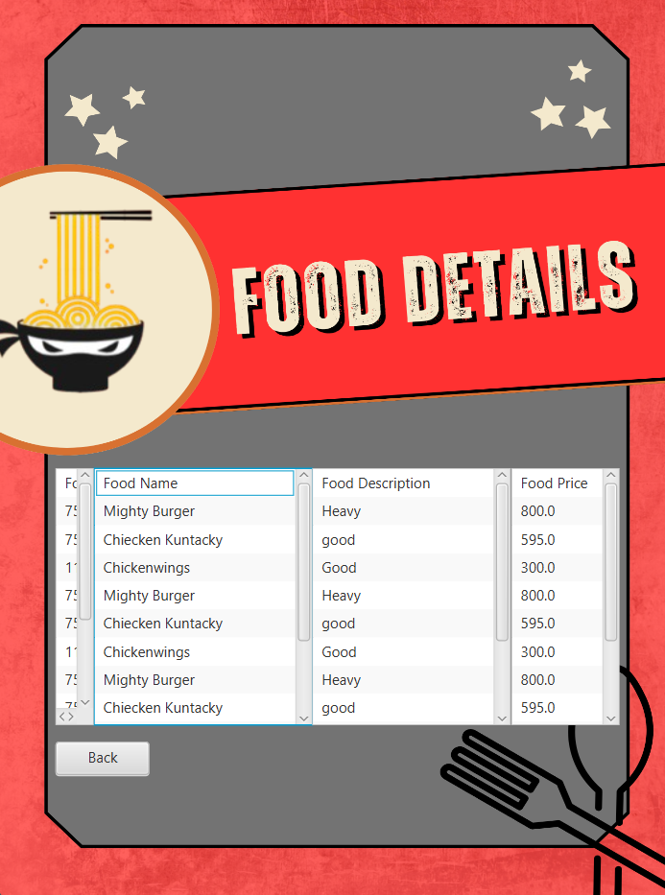
USER INTERFACES - DEMO

Slide 7
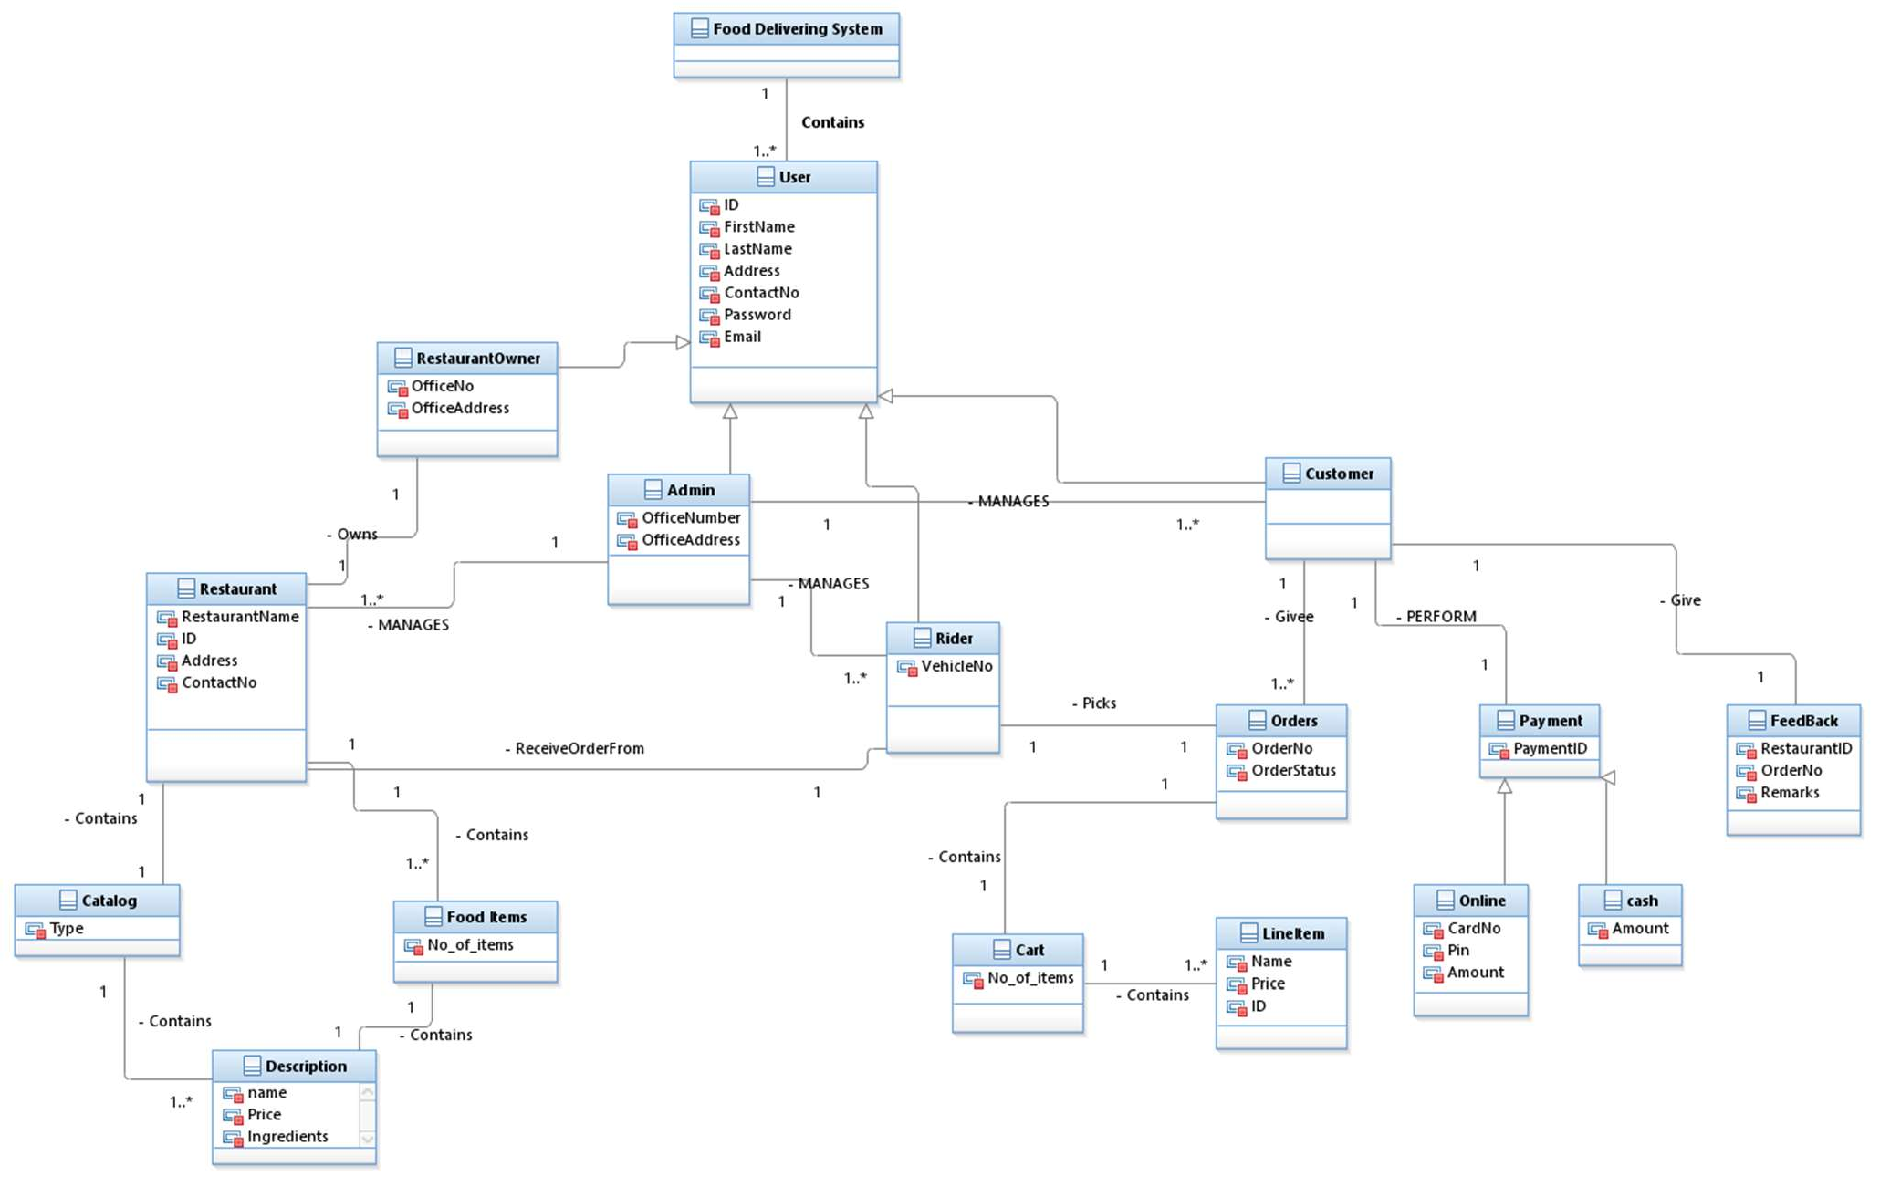
DOMAIN MODEL

Slide 8
SYSTEM SEQUENCE DIAGRAMS

Slide 9
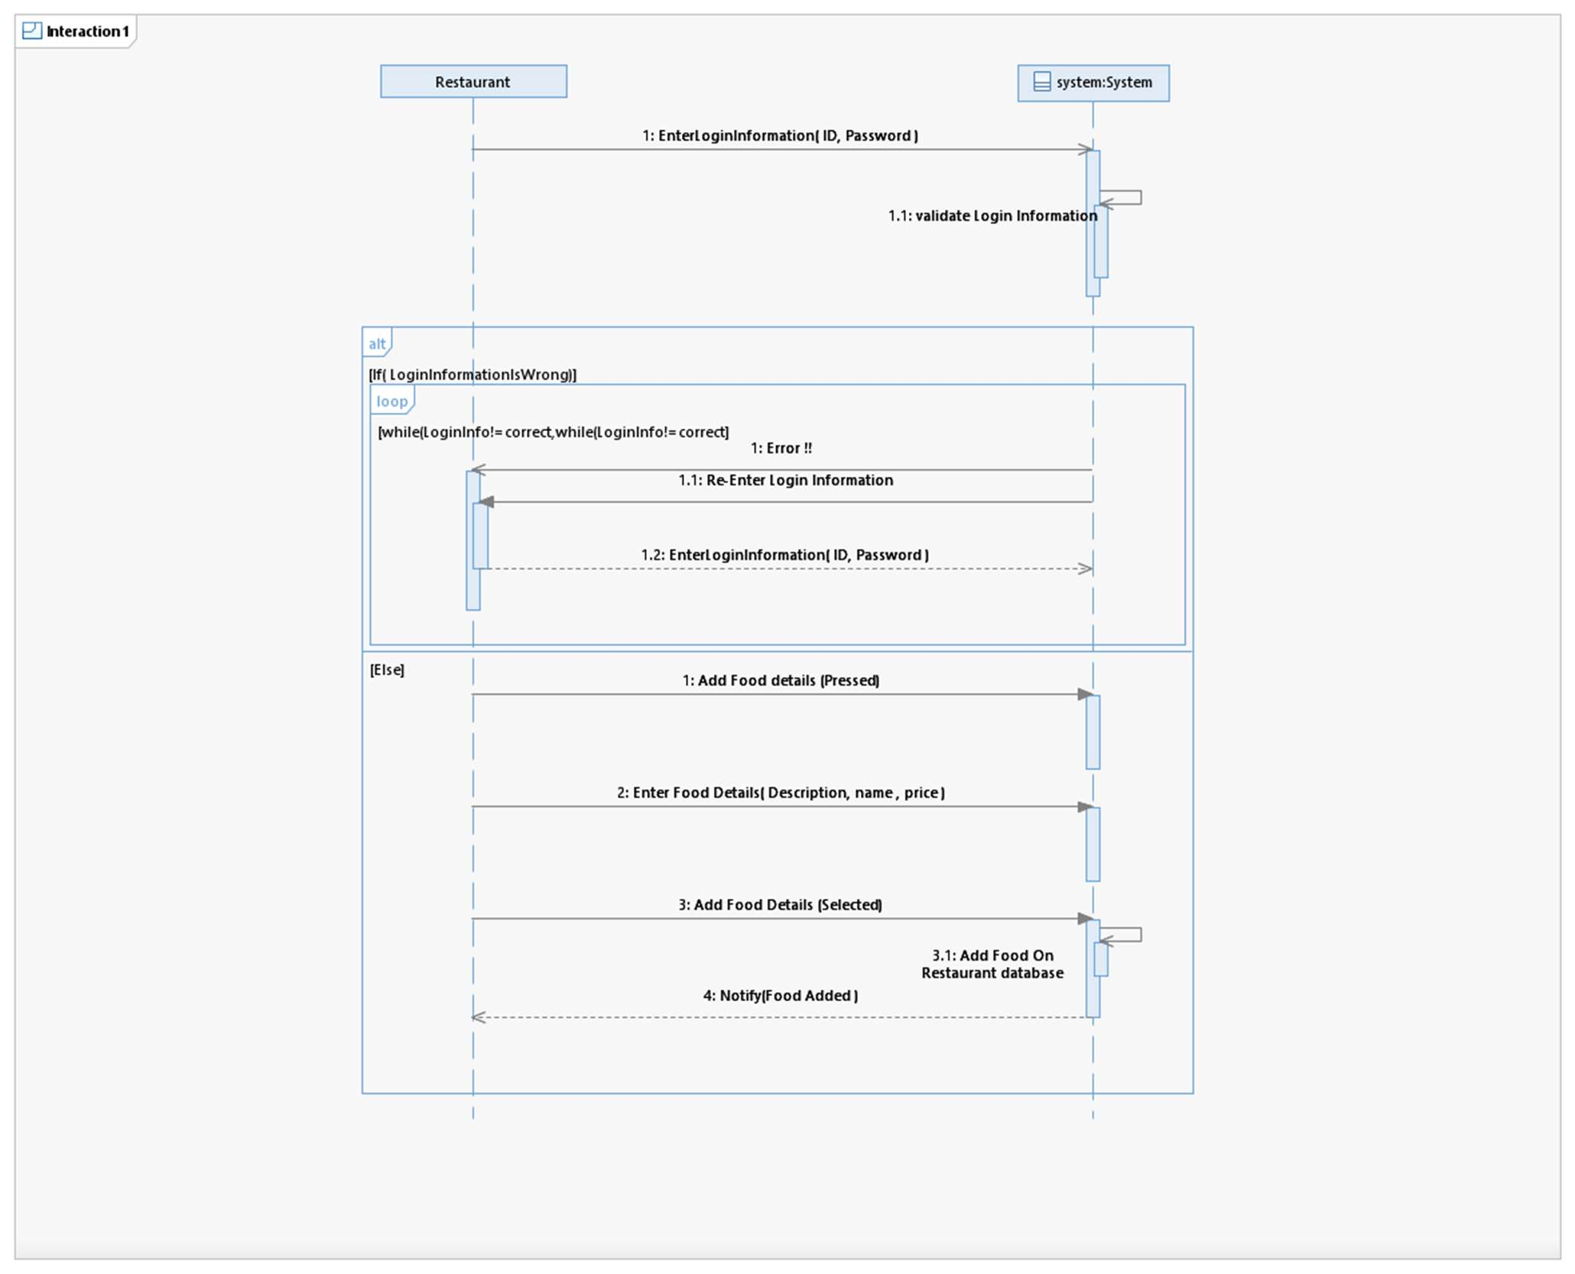
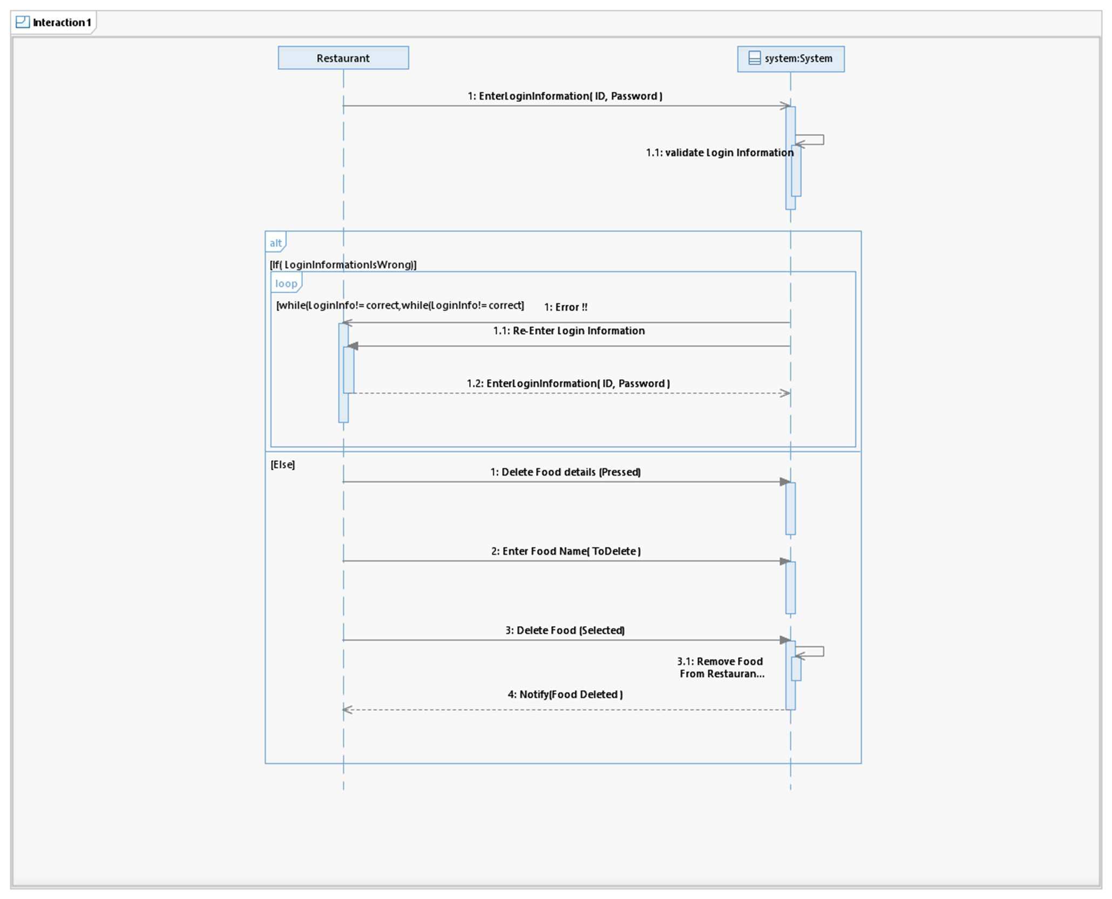

Slide 10
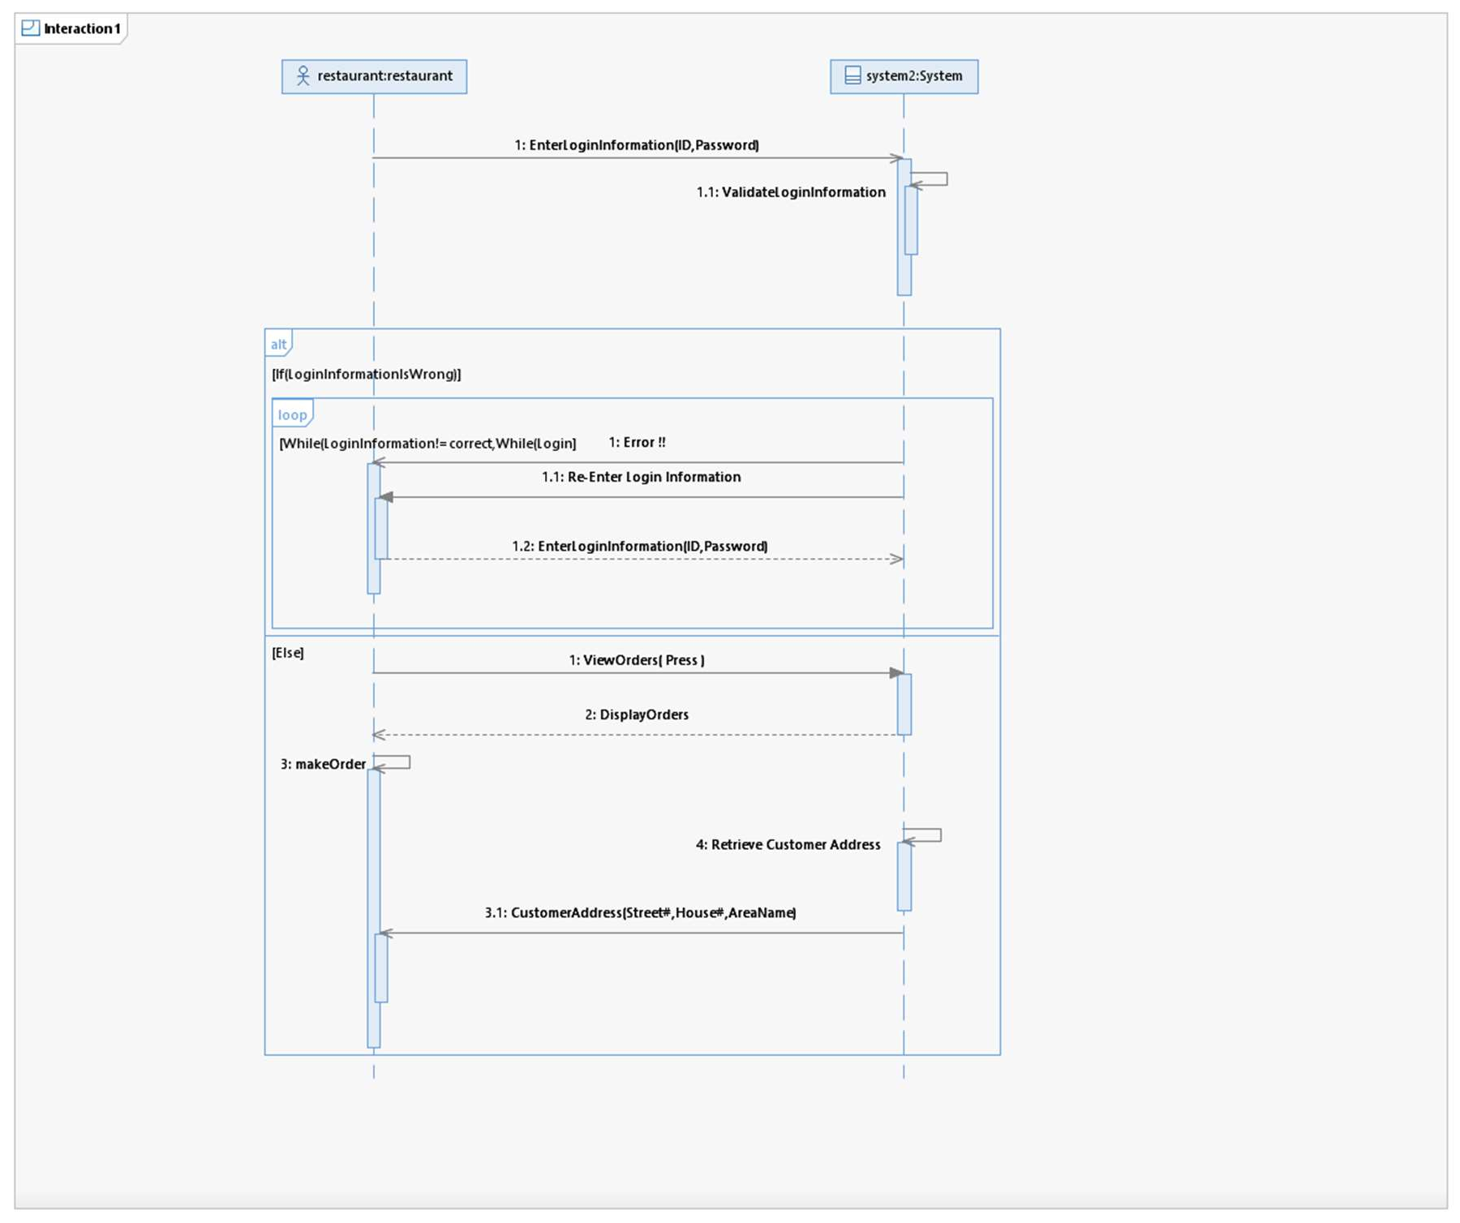
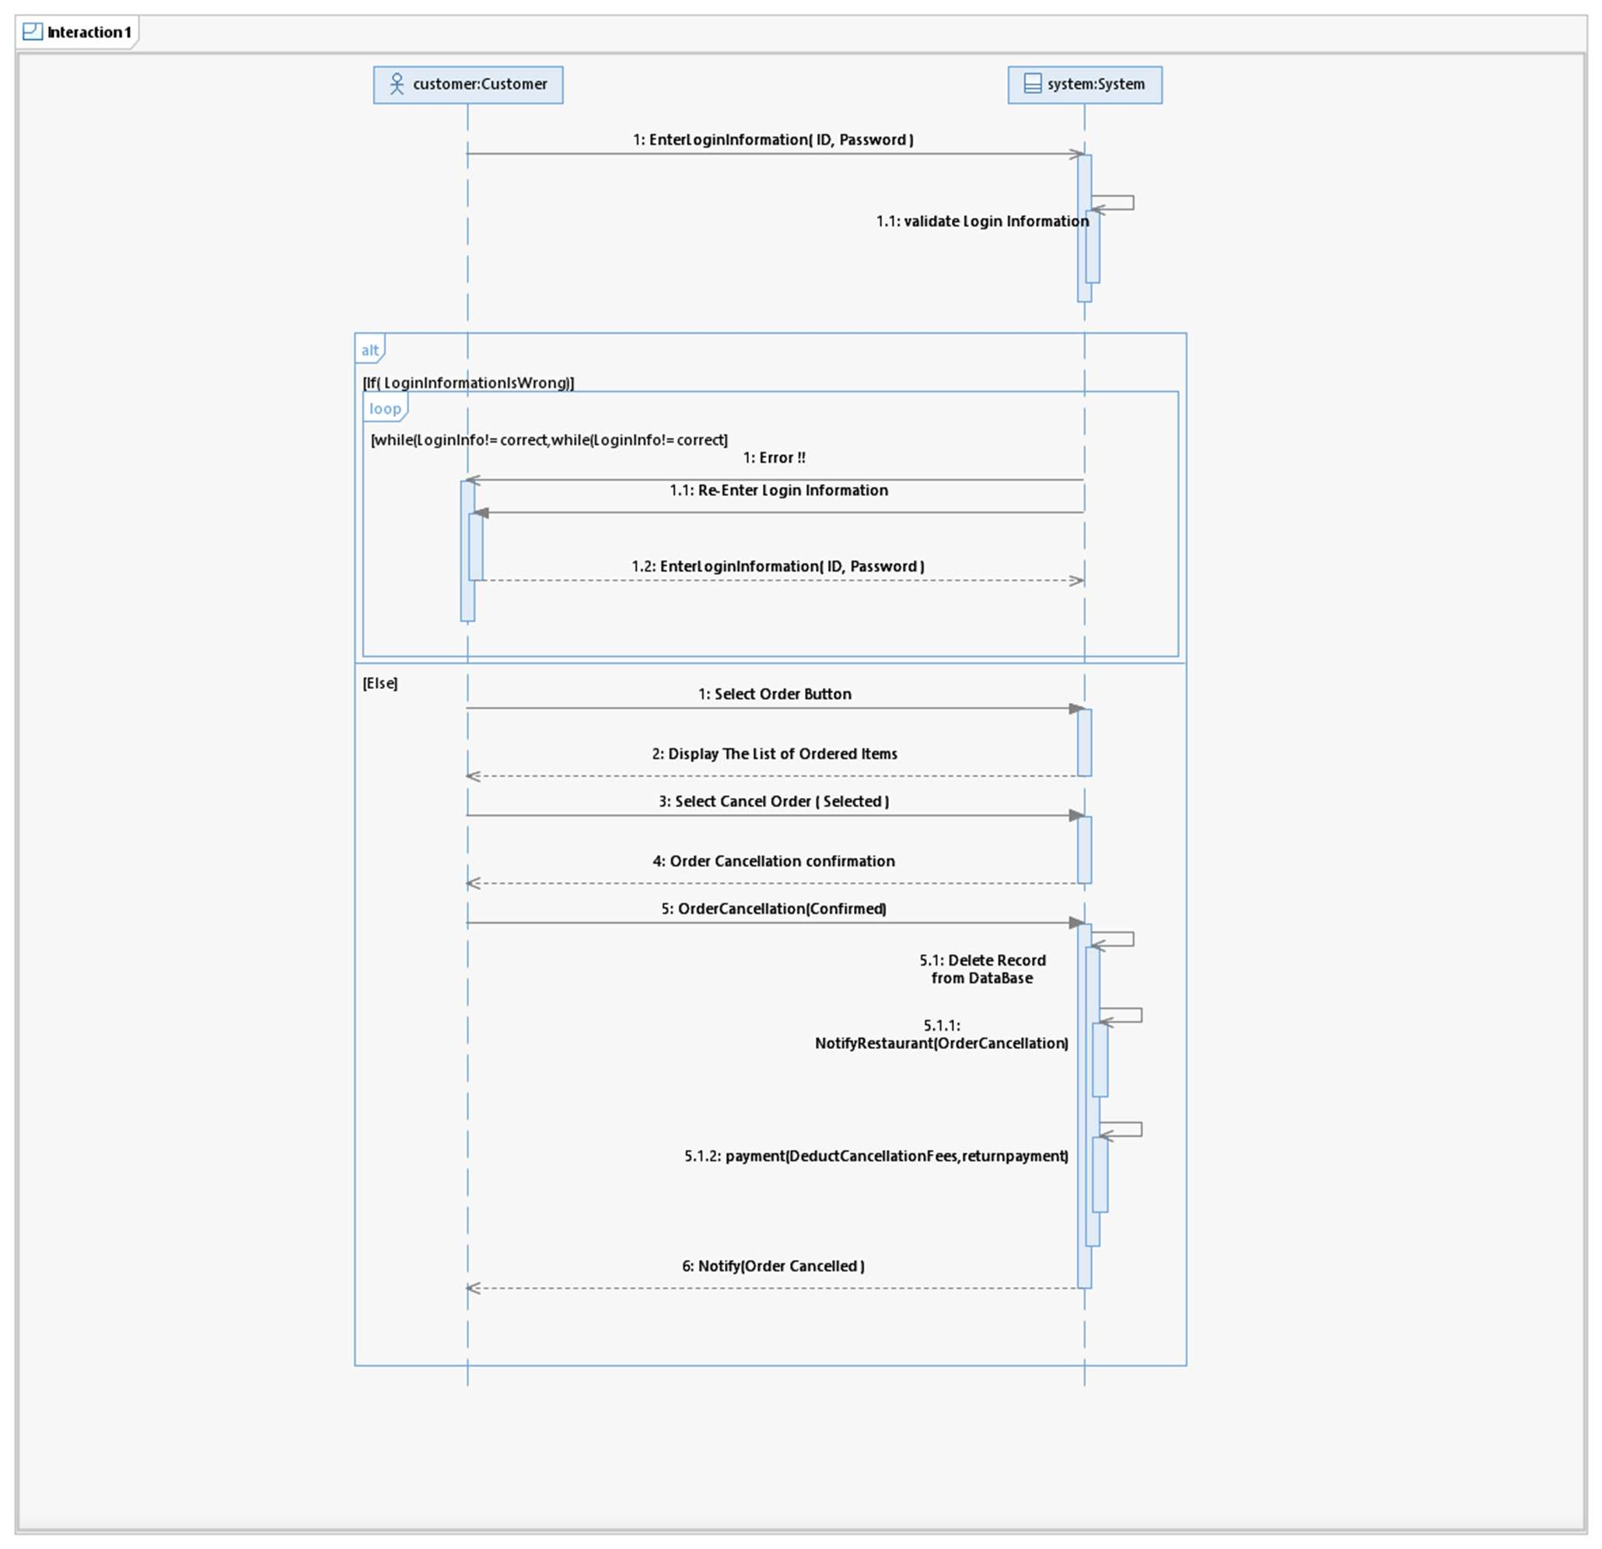

Slide 11
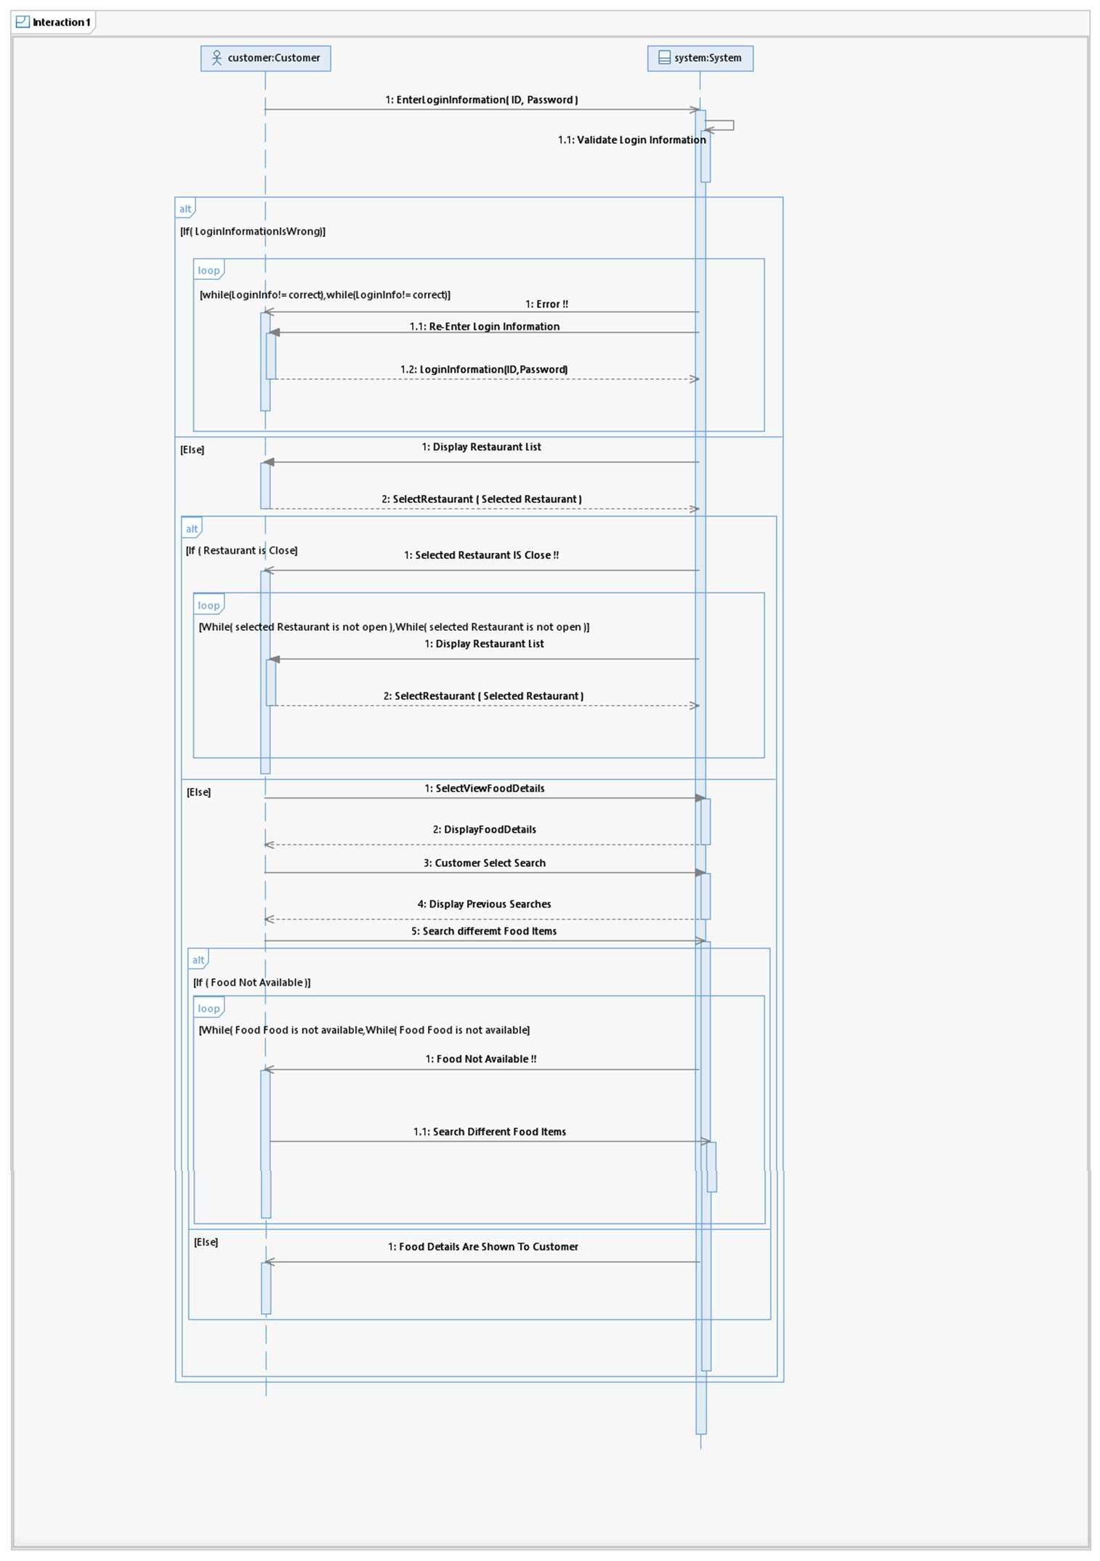
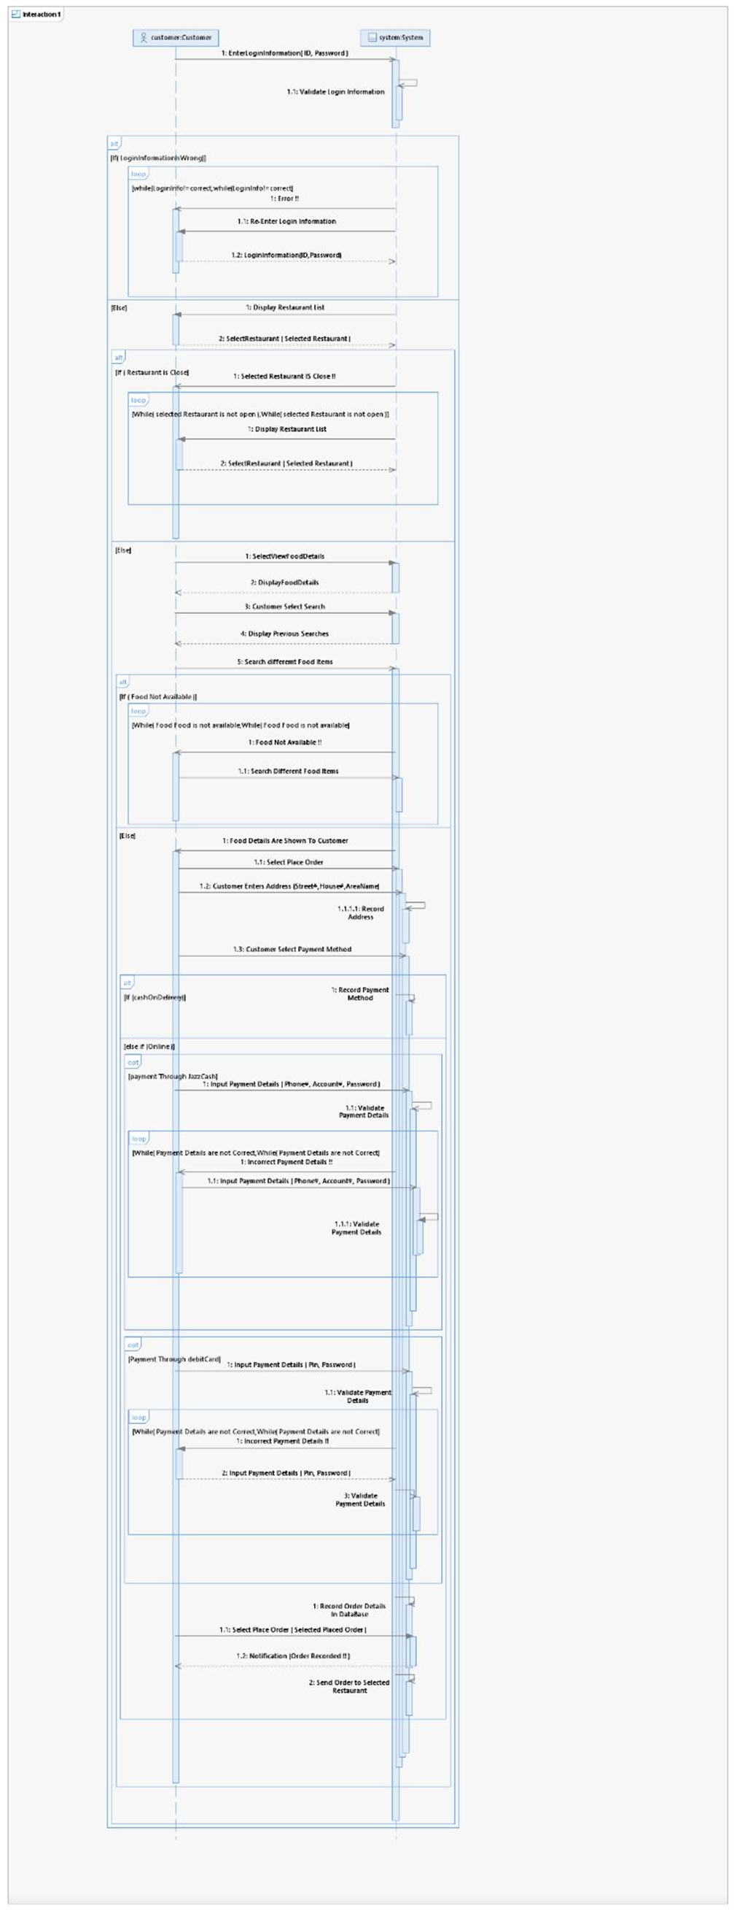

Slide 12
SEQUENCE DIAGRAM

Slide 13
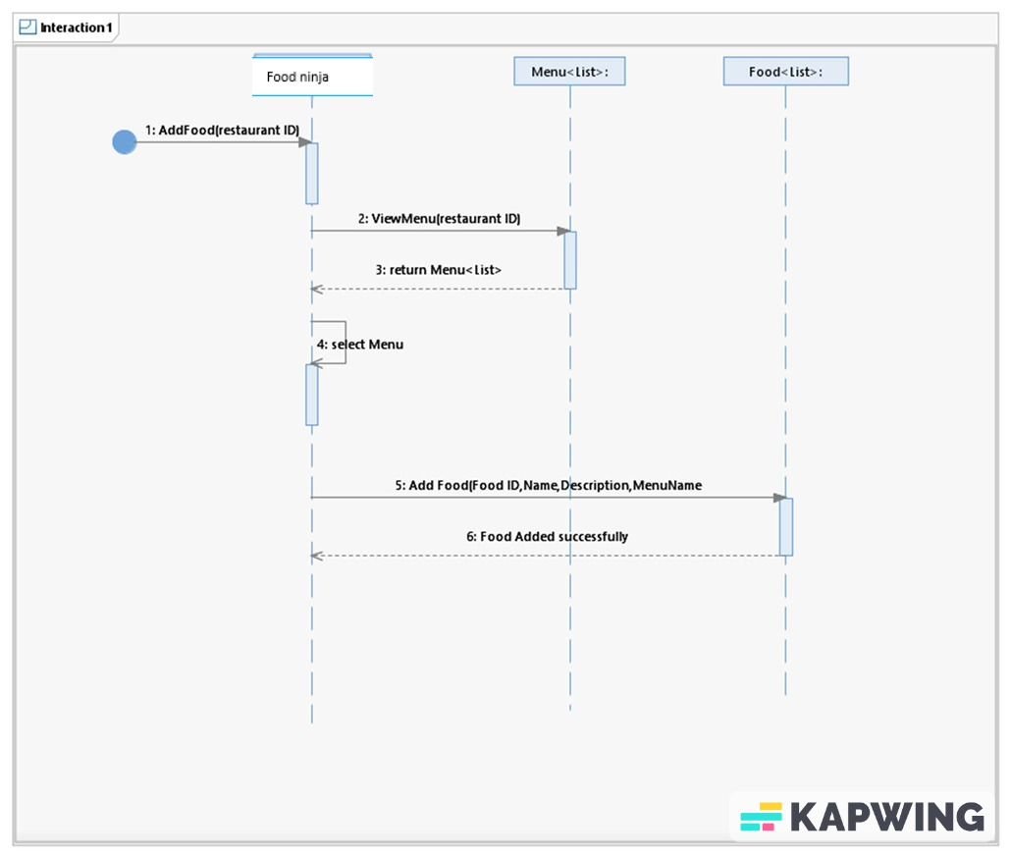
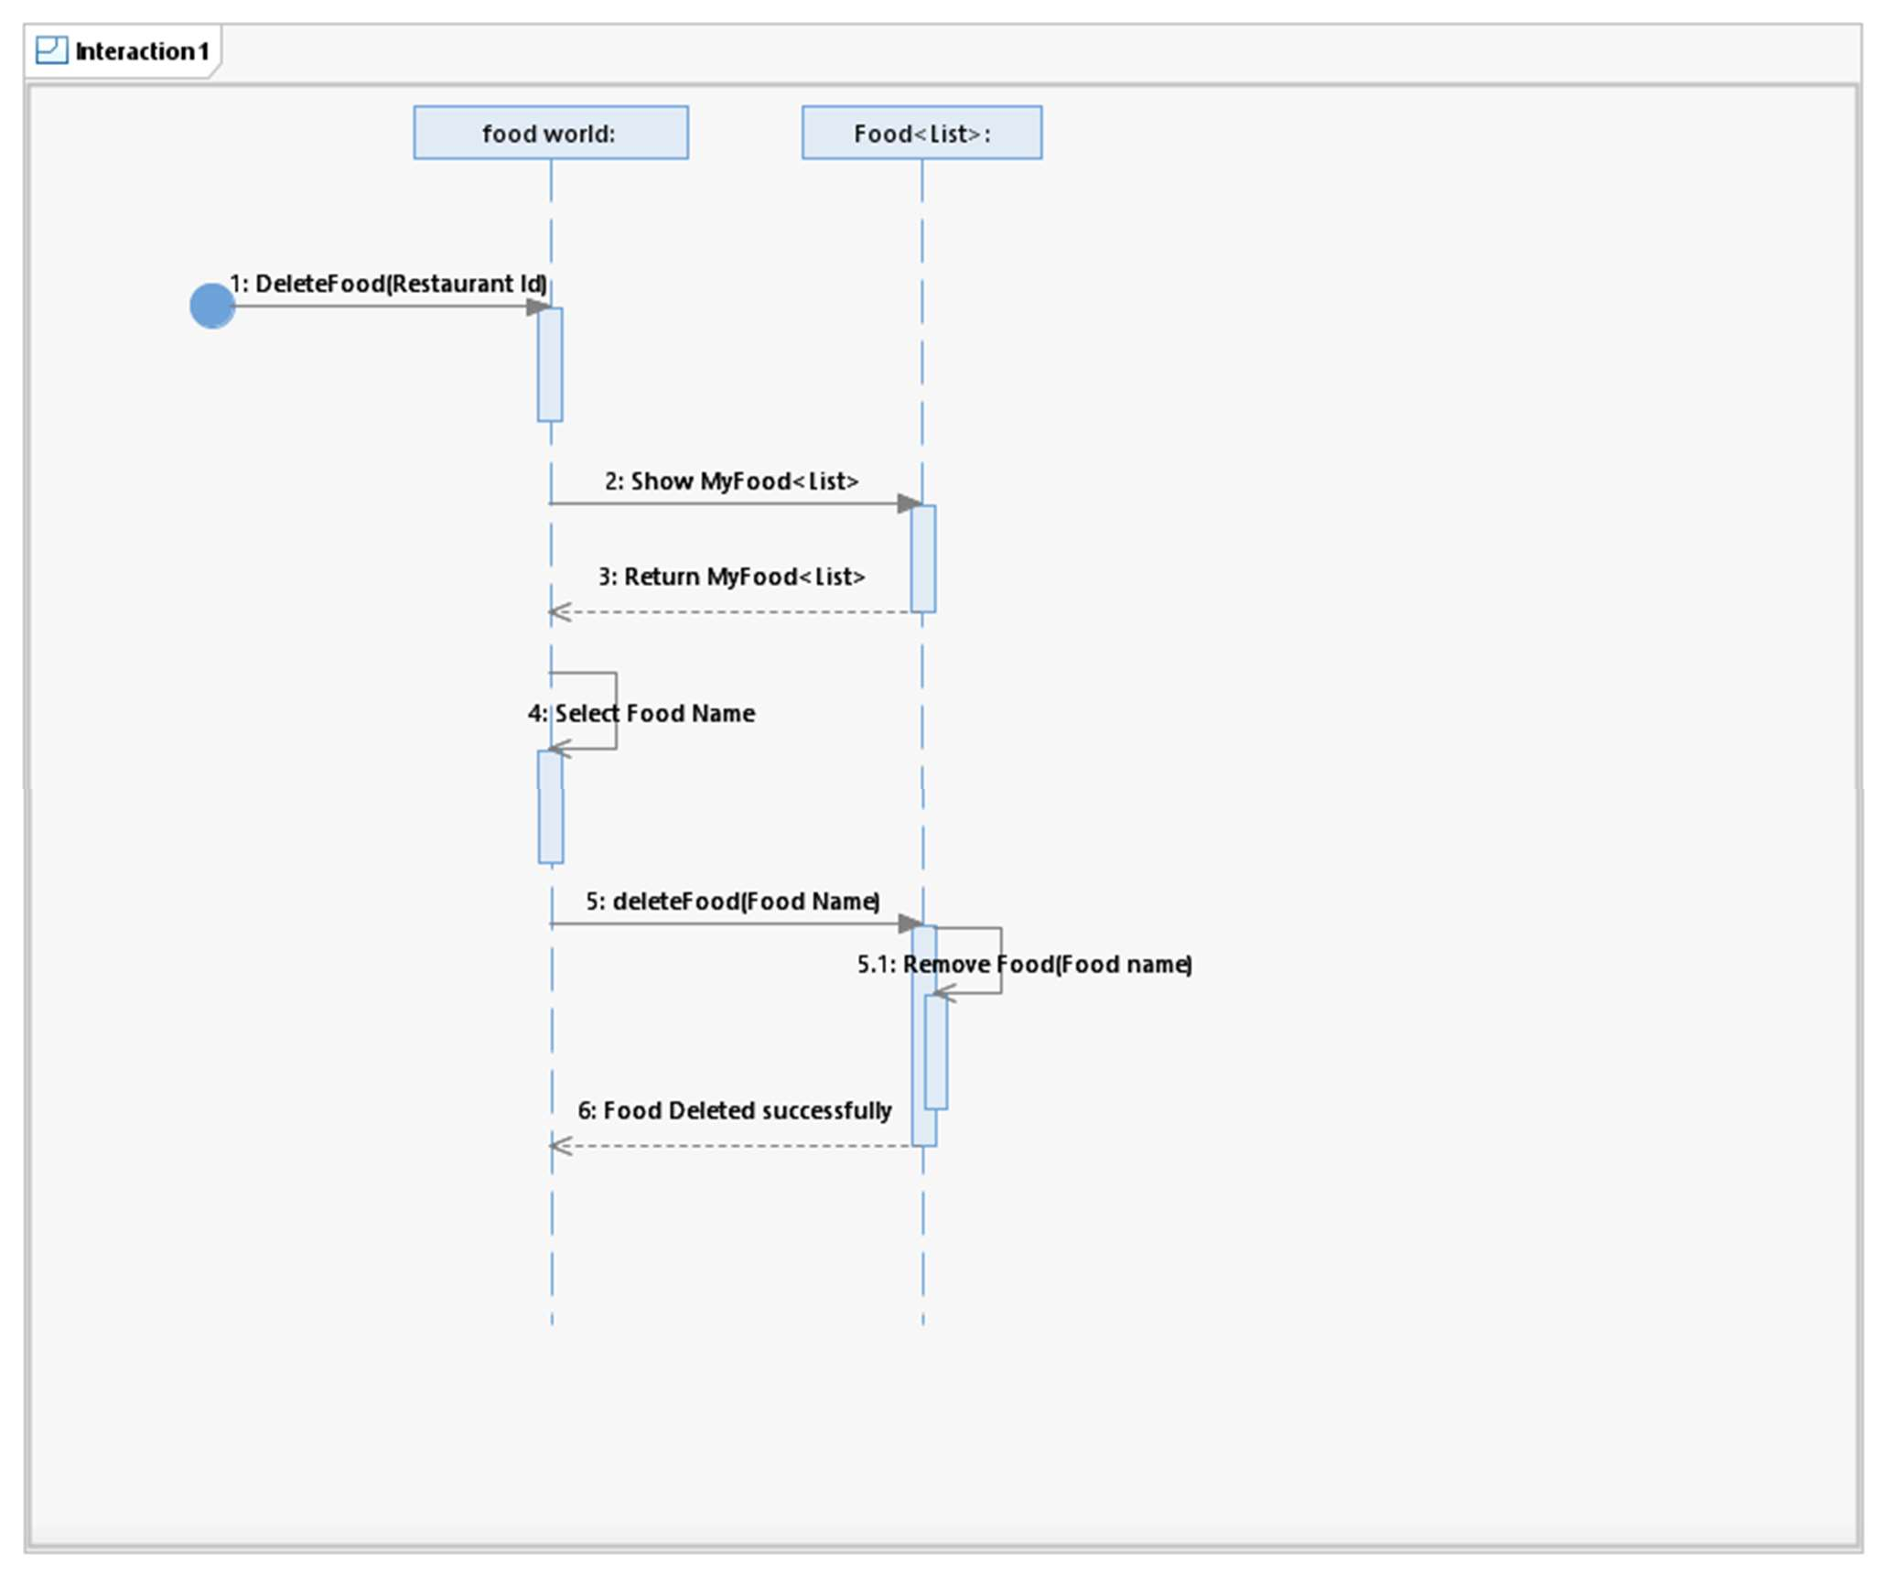
Food ninja

Slide 14
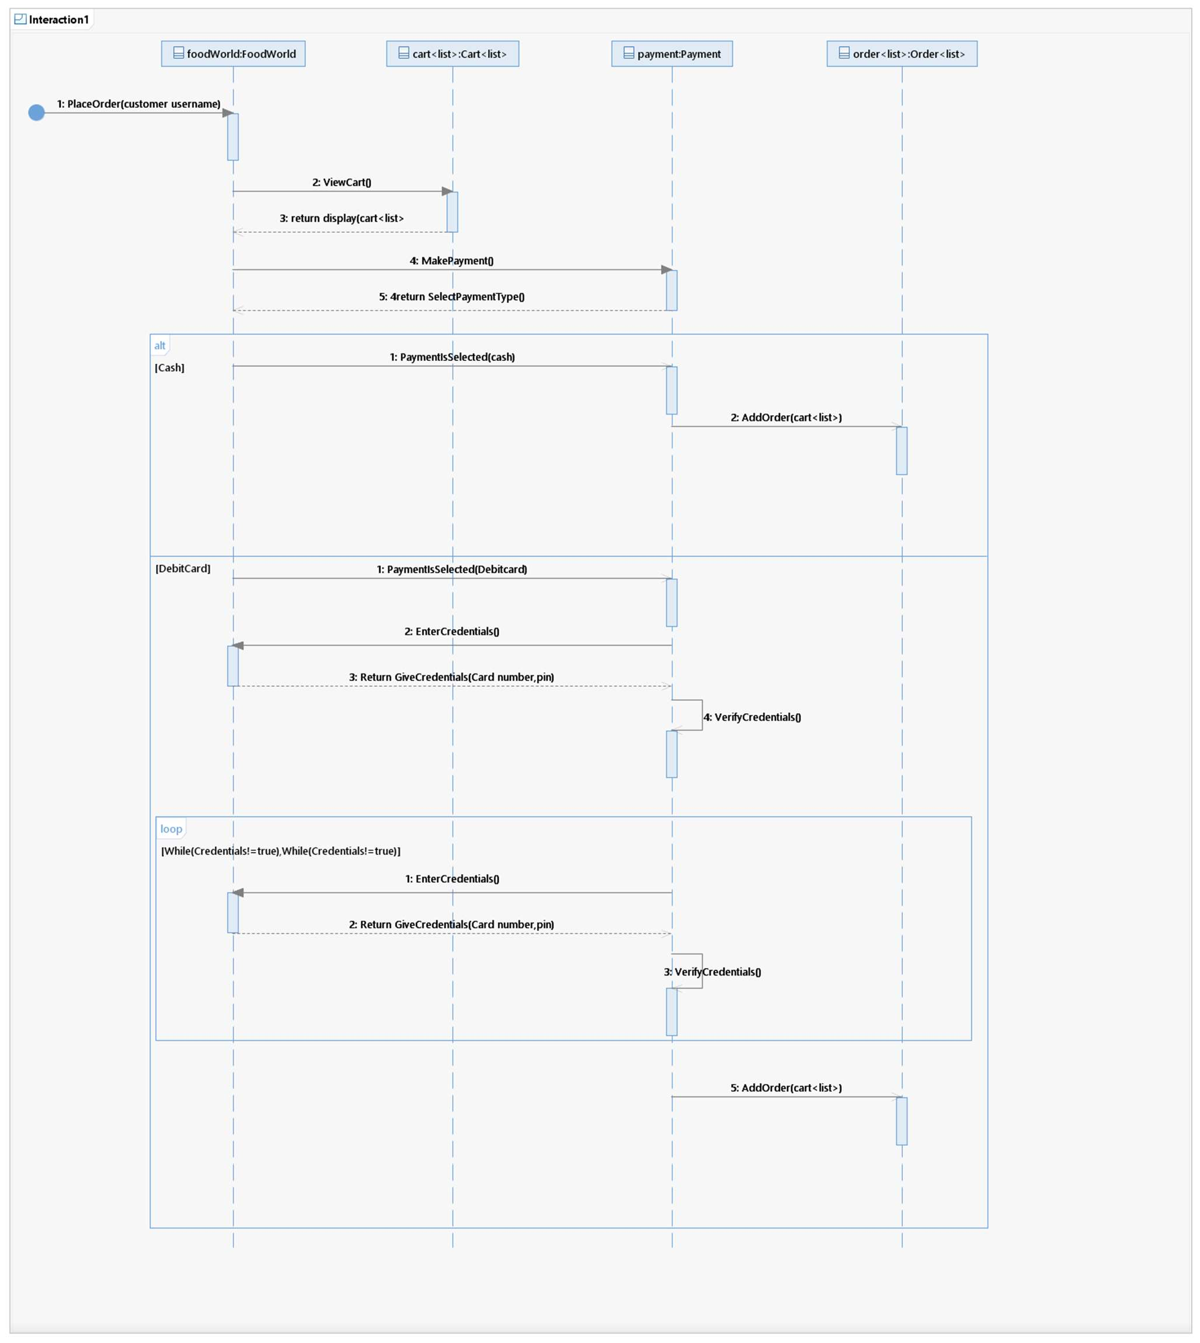

Food ninja
Food ninja

Slide 15
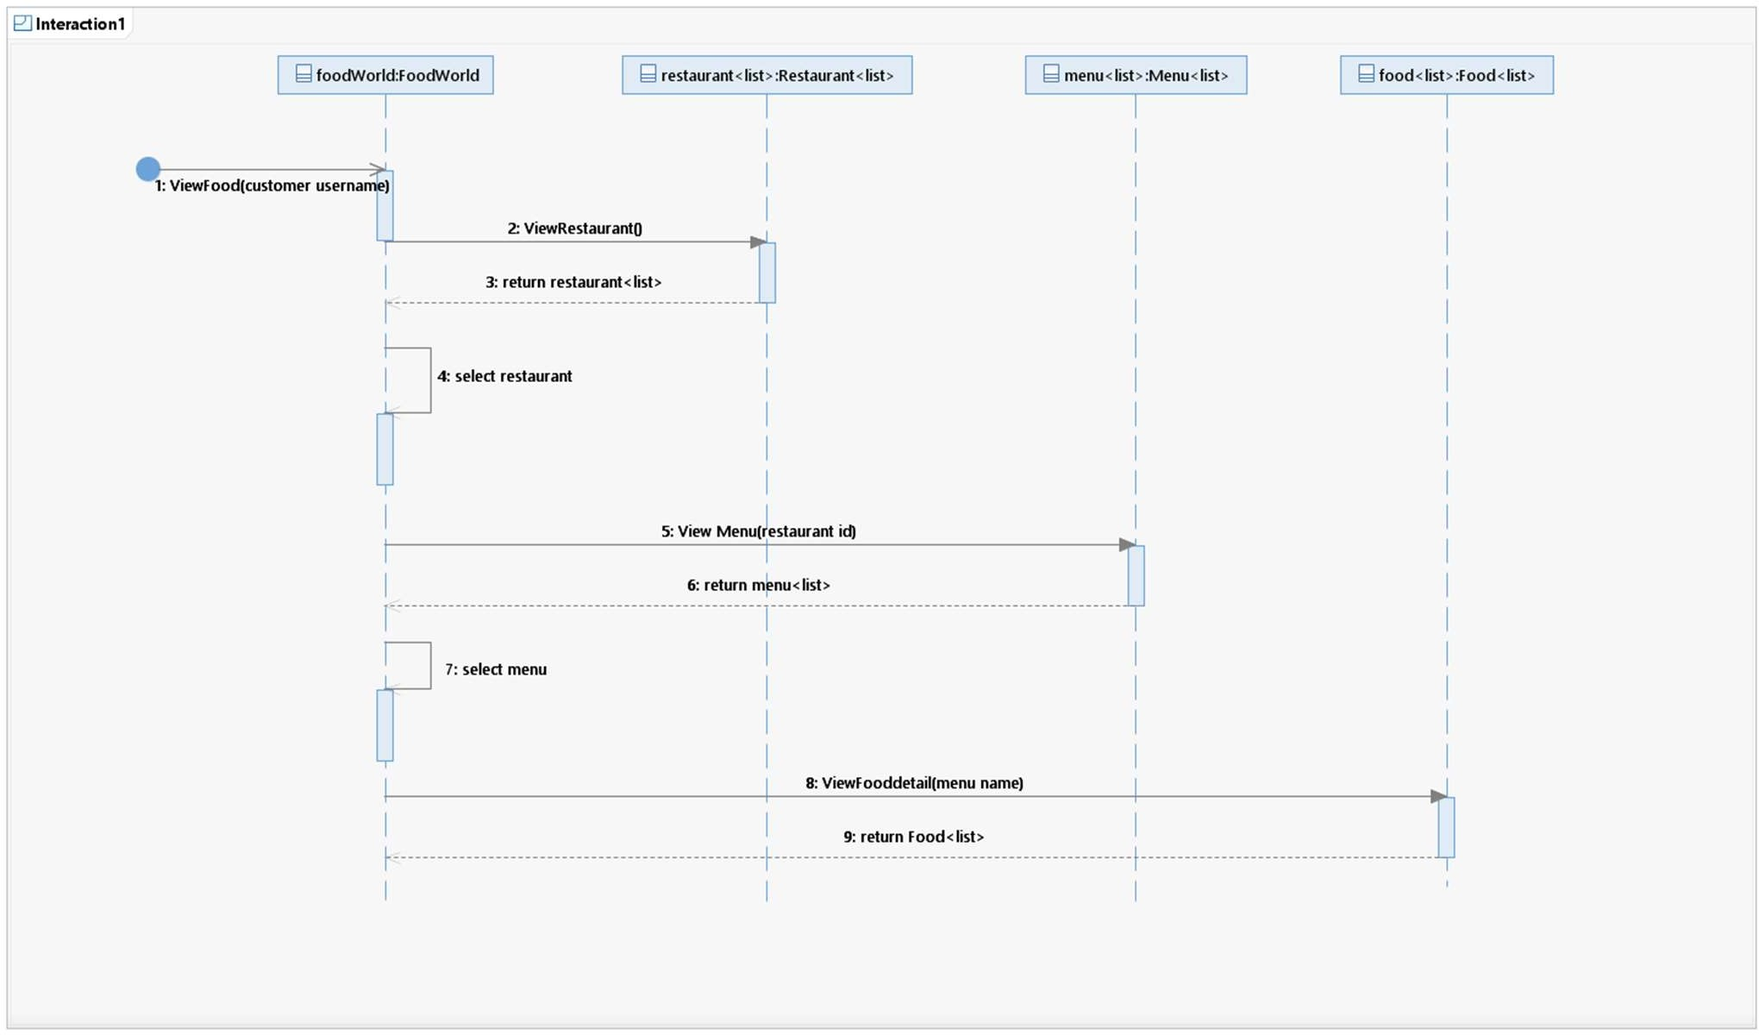
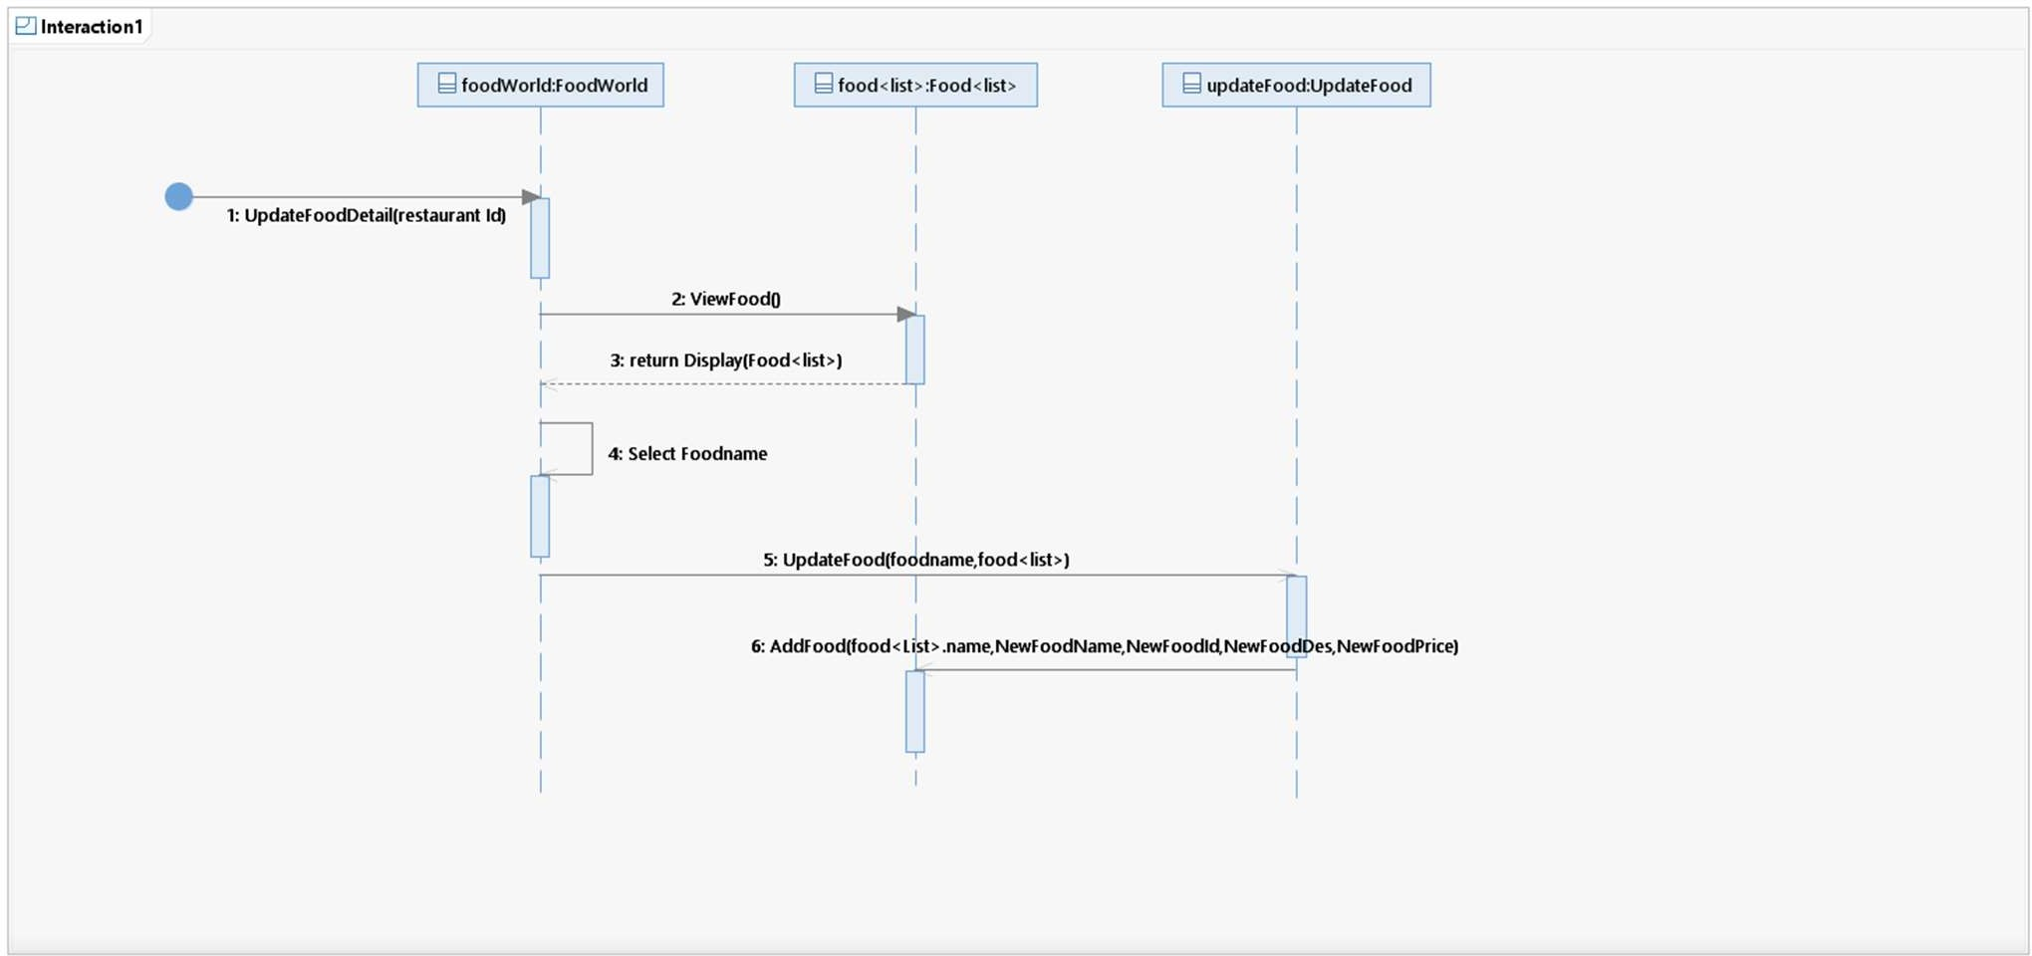
Food ninja
Food ninja

Slide 16
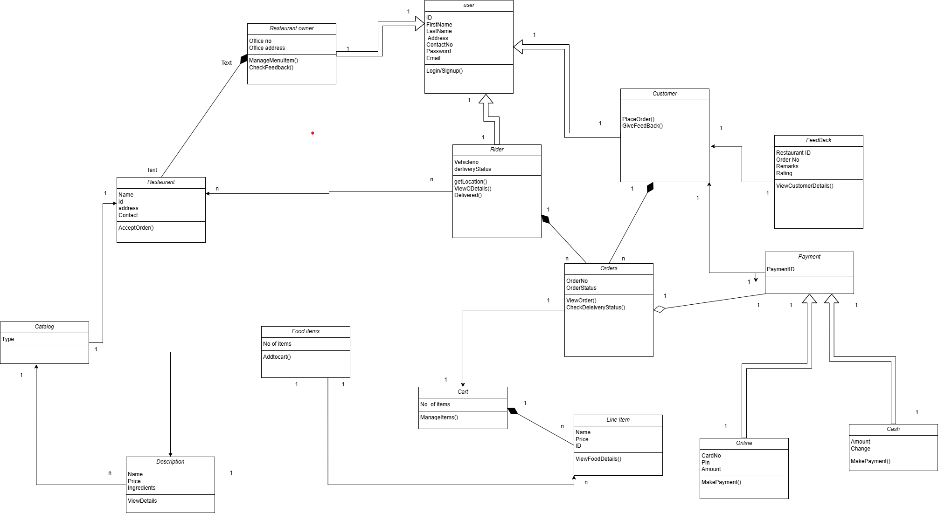
CLASS DIAGRAM

Slide 17


Grasp PATTERNS USED
Creator:
Customer->order
User->all other users (customer, admin, etc)
admin->restaurant/rider
restaurant->menu
Information Expert: Restaurant->Menu.
Restaurant knows its menu.
Cart line item
Rider->Order. Rider knows delivery address
Low Coupling:
payment parent to different ways to pay
user class parent to different types of users
High Cohesion: Ensure classes like Customer, Rider, and Restaurant focus on their roles.
Order doesn't know how rider implements it.
Hidden
File handling so right info passed b/w classes

Slide 18
GoF PATTERNS USED
Factory: To create instances of users (e.g., Customer, Rider) dynamically.
User class creates instances of rider, admin and customer.
Payment for different option. (Cash/Online)
Strategy: For payment options (e.g., implementing different payment methods).
Implement different payment strategies (Cash/Online)
Assigning order to drivers based on customer preference
Observer: For order status updates, where customers get notified when their order status changes.

